Slide 1

BARROW CENTRAL WHEELERS
Club Instagram page: HERE
Club Facebook page: HERE
Open 10 – L1015
Wednesday 19th June 2024
Event Start Time: 18:45, with first rider off at 18:46.
Promoted for and on behalf of Cycling Time Trials under their Rules and Regulations.
Primary Time Keepers: Mrs Tracy Moore & Mr Andrew Sawyer.
Promoting Club Chairman & Race Organiser: Mr James Hodgson.
Race Report:
The infamous L1015 always attracts a crowd and this (mid-week) edition was no exception, with 92 riders on the start sheet from the 101 who had signed up to race.
Riders benefitted from the fast roll-out to the main flatter stretch of the course; the weather (albeit nearly summer) finally gave us something all to cheer about – the sun was shining! Not the fastest of conditions with a slight breeze.
Prize winners can be found on page three of this Race Report.
Thank you to all volunteers and marshals in supporting me to host this event. I would also like to thank the entrants for their support shown to our club; we really do appreciate it. I hope to see you all at the same event next year!
James Hodgson, Chairman of Barrow Central Wheelers Cycling Club.

Slide 2
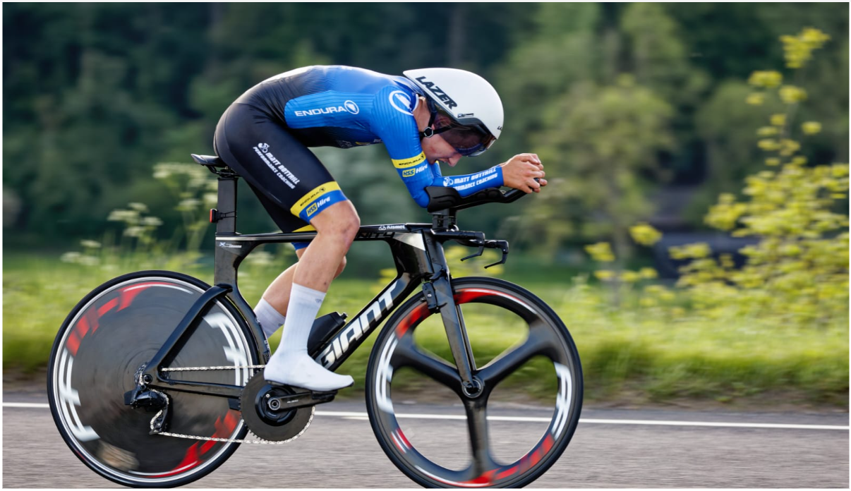
BARROW CENTRAL WHEELERS
Club Instagram page: HERE
Club Facebook page: HERE
Kudos to Junior rider Joe Cosgrove for placing the fastest time of the evening across all categories in a time of
18:51. A fantastic result!
Image supplied courtesy of Joe, himself.

Slide 3
Prizes:
Please contact James Hodgson, Barrow Central Wheelers Chairman at: montythecat98@gmail.com to your claim winnings once the official results are published by the CTT.
Category | No of Riders | 1st Place | 2nd Place | 3rd Place
C5 Female | 1 | £15 – Rebecca Newark | £N/A | £N/A
Junior Female | 2 | £15 – Esther Wong | £10 – Kayla Dinnin | £N/A
Senior Female | 3 | £15 – Emily Martin | £10 – Beth Macrae | £10 – Daisy Barnes
Veteran Female | 4 | £15 – Emma-Jane Bradfield | £10 – Sue Cheetham | £10 – Karen Bailey
Category | No of Riders | 1st Place | 2nd Place | 3rd Place
Youth Male | 2 | £15 – Jamie Rabbett | £10 – Roch Morgan | £N/A
Junior Male | 3 | £15 – Joe Cosgrove | £10 – DNS (A) | £10 – DNS (A)
Espoir Male | 1 | £15 – Matthew Whitehead | £N/A | £N/A
Senior Male | 14 | £15 – Graham Hollinger | £10 – David Parkin | £10 – Sam Taylor
Veteran Male | 62 | £15 – David-James Williams | £10 – Allister Ribbands | £10 –Richard Bideau
Category | No of Riders | 1st Place | 2nd Place | 3rd Place
Trike Male | 2 | £15 – Wayne Baker | £10 – Brian Moore | £N/A
Category | No of Riders | 1st Place | 2nd Place | 3rd Place
Road Bike Male Senior | 3 | £15 – Sam Stephenson | £10 – Joe House | £10 – Alex Thomas
Road Bike Make Veteran | 3 | £15 – Richard Butler | £10 – Richard Morgan | £DNS

